Slide 1
FAKE NEWS DETECTION
Team members:
Rajagopal Naidu Kodavati – 11596822
Jaya naga satya pavan ganesh kotipalli – 11594936
Mounika Katipally - 11734660

Slide 2
Introduction​
The system that detect and separate the text data which is true and which is fake
Classification of the data into appropriate and inappropriate data.
To maintain data integrity.
Used Machine Learning approaches, RNN and NLP tools.

Slide 3
Problem Statement
Misinformation is a big challenge to the internet
Blogs, social networking sites, and online publications.
Loss of data integrity, social disputes, loss of trust and credibility among the users, etc.

Slide 4
Various efforts have been undertaken to identify and categorize false information manually.
Increase in data volume, is a challenging task to manual efforts.
Here comes, Fake news detection using the ML, NLP and Deep Learning (RNN) techniques.

Slide 5
Methodology
Work Flow diagram:
Collection of two datasets(fake&real)
Modify data by adding req features
Merge datasets to one dataset
Remove stopwords,url and panctuation from text
Result with predection of accuracy of fake and real data
Train the data to build model prediction
Apply only text data in dataset for easy analysis

Slide 6






Architecture diagram:
Prepare and gather dataset(Fake data and real data)
Merge datasets to one data and adding required features to data
Cleaning the raw and text data by removing stopwords and other non usefull material in text
Only text data is considered in data
Analysis and Accuracy of model
Building the model by training the data and predicting output and using some Deeplearning models and NLP tools

Slide 7
Description of Dataset
Used datasets from Kaggle
True.csv - Dataset with valid information
Fake.csv - Dataset with misinformation

Slide 8
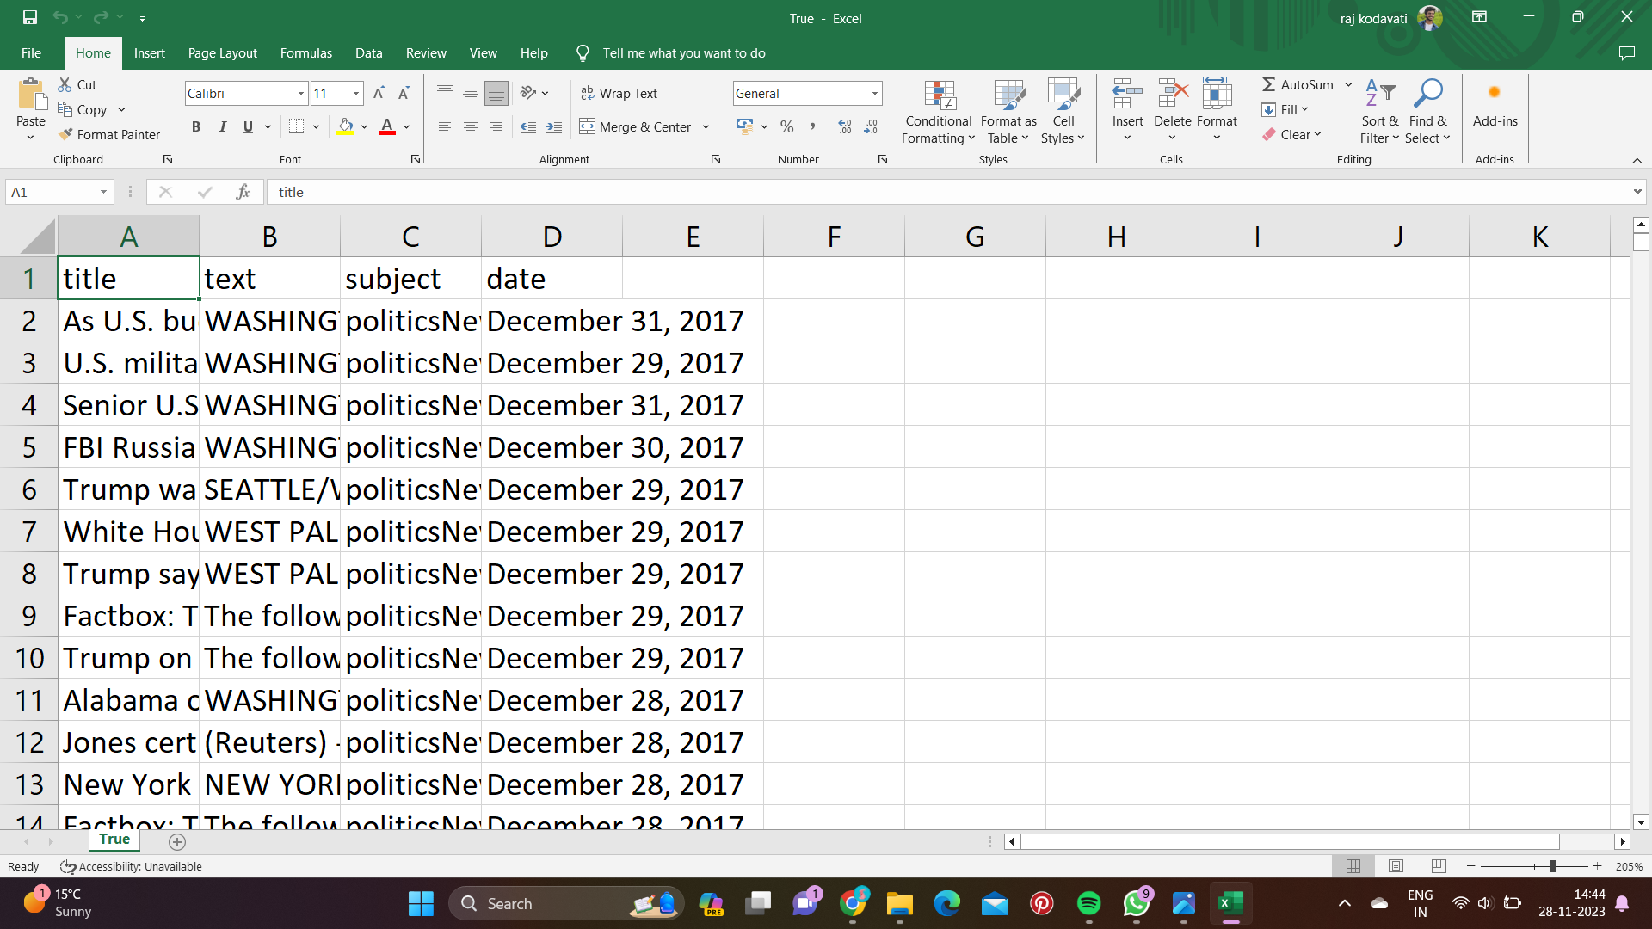
Design of features:

Slide 9
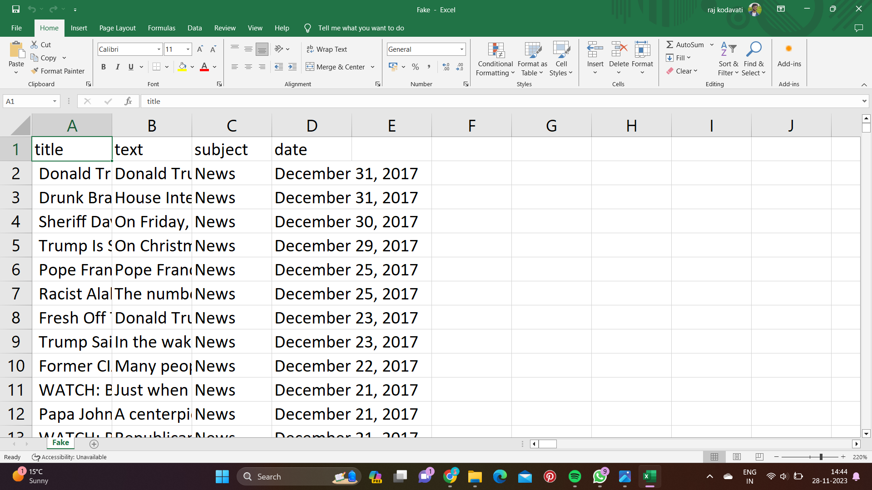

Slide 10
The first and second screen shorts from the above slide are real and fake news datasets.
The features of both datasets are same which are title, text, date, and subject.
We also add one more feature is_news to dataset which describes 1 for fake text and 0 for True text.
We combine both real and fake news dataset to one dataset called news.

Slide 11
Exploratory Data Analysis
Data Visualization :
A bar plot is created using Seaborn's "countplot".
The distribution of true or fake information in the dataset is visualized.
The count of each category ('is_news_fake') is shown here.

Slide 12
The performance of the model is visualized using confusion matrix.
A heatmap is plotted using Seaborn and Matplotlib.
Predicted vs. actual labels for the test set are shown here.

Slide 13
Data Preprocessing :
The two datasets ('Fake.csv' and 'True.csv') are combined in to one DataFrame called 'news'.
A new categorical feature is created.
The number of values that are missing in each column are verified and counted.

Slide 14
HTML tags, URLs and text within square brackets are removed.
Using NLTK's stopwords list and string library, BeautifulSoup, and regular expressions, the stopwords and punctuations are removed from text respectively
'text' and 'title' columns are merged and 'date', 'subject', 'title' columns are dropped from the dataframe.

Slide 15
Keras' Tokenizer is used to tokenize the text data and convert into sequential data.
To have a uniform input size, the sequential data is then padded to a maximum length.
The 'glove.6B.100d.txt' file is used to load the word embeddings of GloVe.
In order to map the words to their corresponding pre-trained word vectors, an embedding matrix is created.

Slide 16
Implementation
Algorithms used:
Long short-term memory (LSTM)
An RNN which is a Deep Learning Technique.
Handles and processes the sequential data.

Slide 17
Libraries Used :
Pandas: Used to read the csv files of the datasets.
Seaborn and Matplotlib: Used for Data visualization in the form of graphs and display the confusion matrix
NLTK (Natural Language Toolkit): Used for Data cleaning (Tokenization)
BeautifulSoup: HTML tags and URL's are removed using this library.

Slide 18
String: Used to remove punctuations.
Regular Expressions (re module): Used to remove square brackets.
Scikit-learn: A machine learning library to perform data preprocessing, training, classification, test, build confusion matrix and find the accuracy.
WordCloud: used to display the word frequency

Slide 19
Keras with TensorFlow backend: Used to build and train neural network model and also to convert the text data into sequential data.
NumPy: Used to create multi-dimensional arrays, matrices and mathematical functions to operate on the arrays. Here, we had created confusion matrix to find performance of the model.
ReduceLROnPlateau (Keras Callback): We callback Keras using this function and used to prevent the model from overfitting and increase model accuracy.

Slide 20
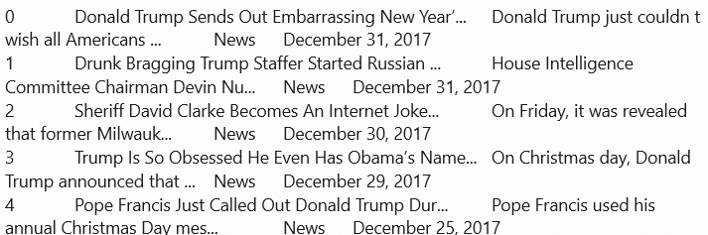
Outputs

Slide 21
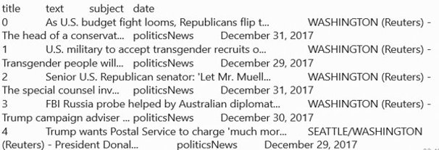

Slide 22
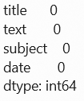
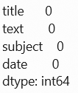



Slide 23
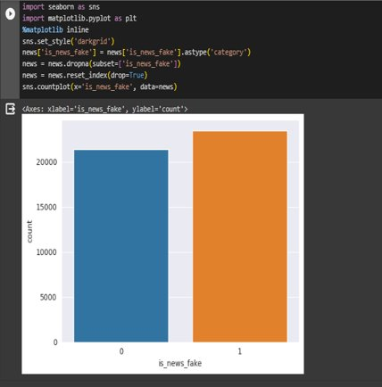
Comparing the datasets

Slide 24
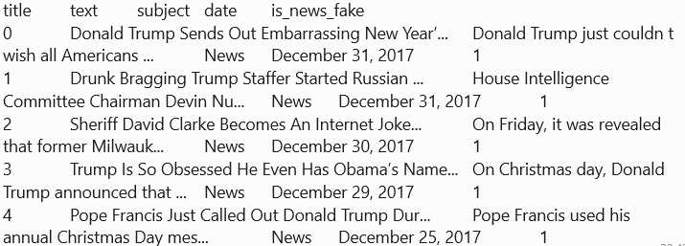

Slide 25
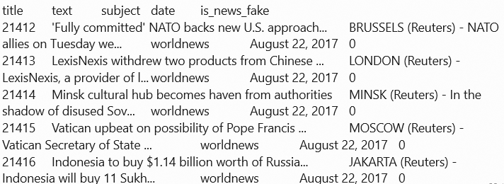

Slide 26
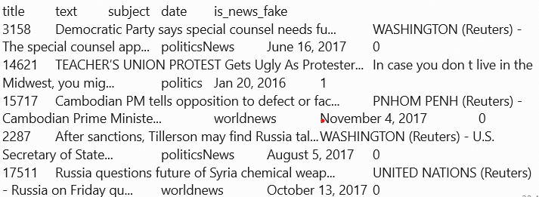

Slide 27
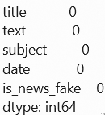
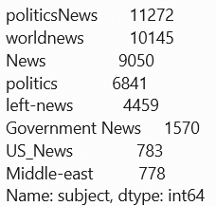

Slide 28
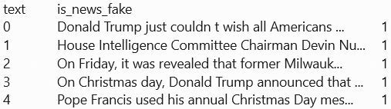
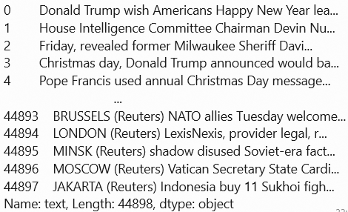

Slide 29
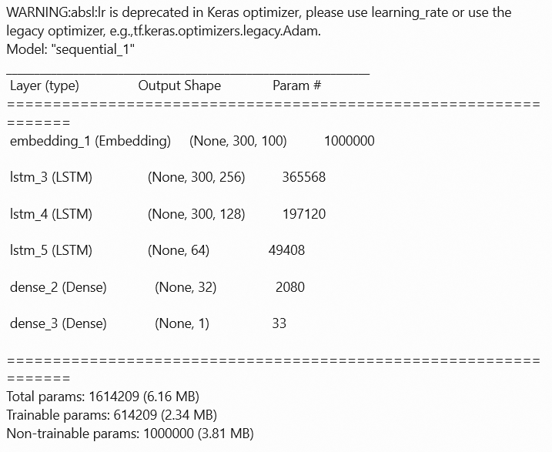

Slide 30
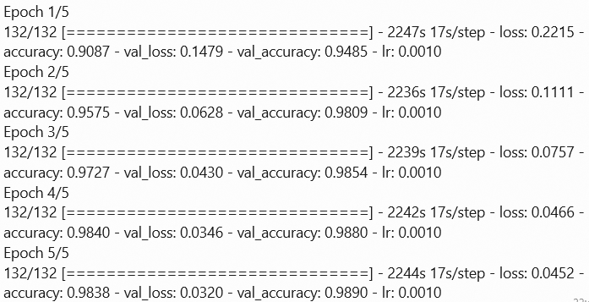

Slide 31
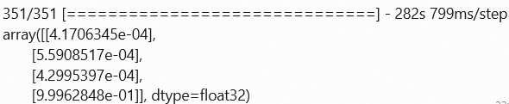
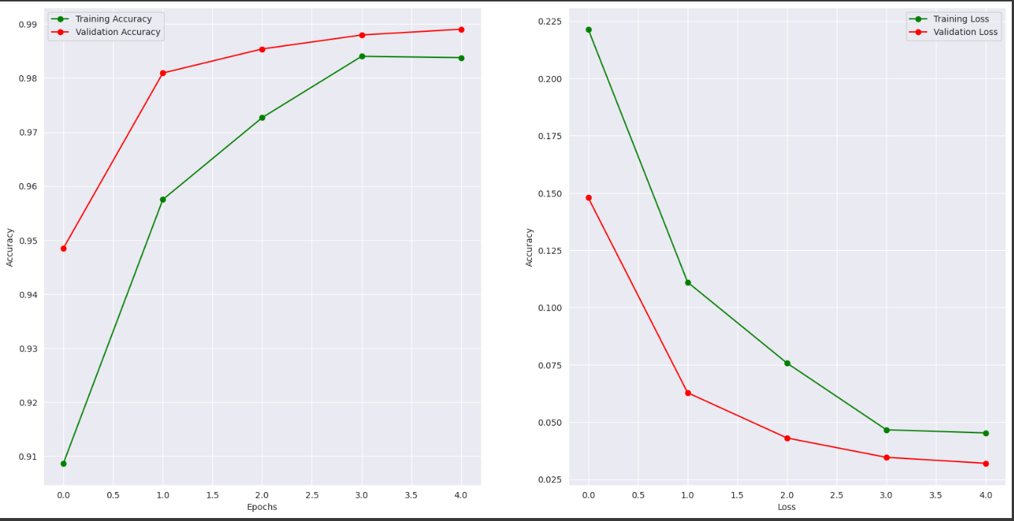

Slide 32
Project Management
Implementation Status report:
Work Completed:
Description:
Our project was on Fake news detection for this model we use nltp tools to clean the data and process text information to the model, we also keras, sklearn model to analyse the model and predict the output.
Responsibility:
Rajagopal Naidu Kodavati work with source code and data collection
Jaya naga satya pavan ganesh helps in proposal documentation and data cleaning
Mounika works with preparing final ppt

Slide 33
Contibution:
Rajagopal Naidu Kodavati – 40%
Jaya naga satya pavan ganesh kotipalli – 30%
Mounika Katipally – 30%
Issues/ concerns:
We face some issues in source code like predicted the data and later on missing some information in proposal so we try to fulfill in final submission and analysing of model so we try different methods in Deeplearning models.

Slide 34
References:
Hunt, Elle (December 17, 2016). "What is fake news? How to spot it and what you can do to stop it". The Guardian. Retrieved January 15, 2017.
Gross, Terry (October 2016). "The Twitter paradox: How a platform designed for free speech enables internet trolls". NPR. Retrieved May 30, 2018.

Slide 35
Video Link:
Github link:

